Slide 1

50.039 Theory and Practice of Deep Learning W1-S2 Introduction and Machine Learning Reminders
Matthieu De Mari

Slide 2
About this week (Week 1)
What are the typical concepts of Machine Learning to be used as a starting point for this course?
What are the different families of problems in Deep Learning?
What is the typical structure of a Deep Learning problem?
What is linear regression and how to implement it?
What is the gradient descent algorithm and how is it used to train Machine Learning models?
What is polynomial regression and how to implement it?
What is regularization and how to implement it in Ridge regression?

Slide 3
About this week (Week 1)
What is overfitting and why is it bad?
What is underfitting and why is it bad?
What is generalization and how to evaluate it?
What is a train-test split and why is it related to generalization?
What is a sigmoid function? What is a logistic function?
How to perform binary classification using a logistic regressor and how is it related to linear regression?

Slide 4
About this week (Week 1)
What are Neural Networks and how do they relate to the biology of a human brain?
What is a Neuron in a Neural Network and how does it relate to linear/logistic regression?
What is the difference between a shallow and a deep neural network?
How to implement a shallow Neural Network manually and define a forward propagation method for it?
How to train a shallow Neural Network using backpropagation? How to define backward propagation and trainer functions?

Slide 5
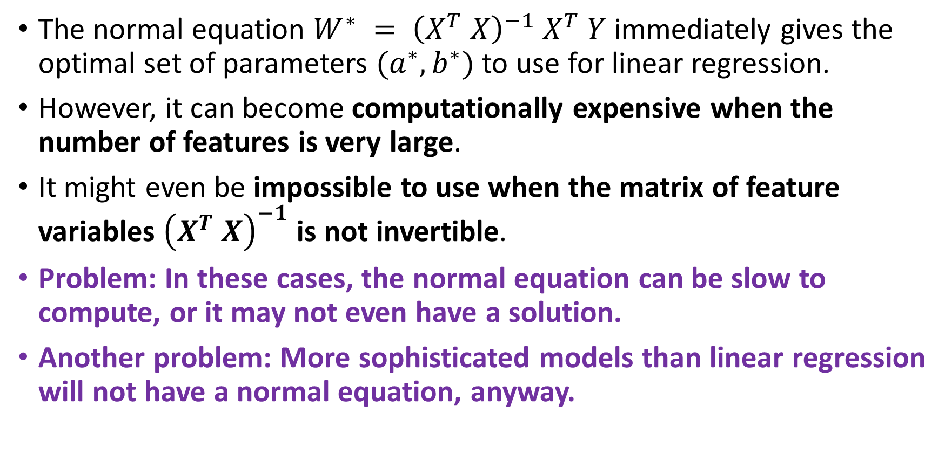
A problem with the normal equation
The normal equation $W^{∗} = {\left(X^{T} X\right)}^{−1} X^{T} Y$immediately gives the optimal set of parameters $(a^{∗}, b^{∗})$to use for linear regression.
However, it can become computationally expensive when the number of features is very large.
It might even be impossible to use when the matrix of feature variables ${\left(X^{T} X\right)}^{−1}$ is not invertible.
Problem: In these cases, the normal equation can be slow to compute, or it may not even have a solution.
Another problem: More sophisticated models than linear regression will not have a normal equation, anyway.

Slide 6
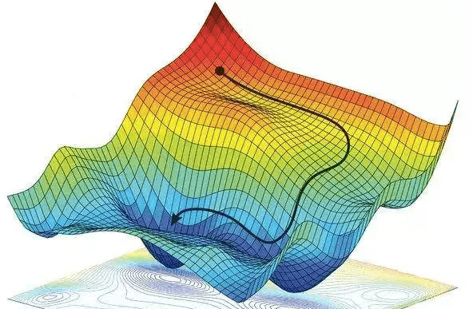
Gradient Descent, to the rescue!
Definition (Gradient Descent):
Gradient Descent (GD) is an iterative algorithm used to solve optimization problems.
It starts with an initial set of parameters.
It then repeatedly updates the parameters in the direction of the negative gradient of the given cost function, until it converges to a local minimum.
Forgot about GD? Have a look at your notes from 10.013 M&A!

Slide 7
Gradient Descent, to the rescue!
Definition (Gradient Descent):
Gradient Descent (GD) is an iterative algorithm used to solve optimization problems.
It starts with an initial set of parameters.
It then repeatedly updates the parameters in the direction of the negative gradient of the given cost function, until it converges to a local minimum.
The normal equation has many problems…
But GD, on the other hand can be used to find the optimal solution even when the normal equation is not applicable.
The main advantage of gradient descent is that it can handle very large datasets and it can also be used for non-linear models.

Slide 8

GD in Linear Regression
In the case of Linear Regression, with the MSE loss defined earlier, we have
$$\left(a^{∗},b^{∗}\right)= arg\min_{a,b} \left[L(a, b,x, y)=\frac{1}{N}\sum_{i=1}^{N}{{\left(ax_{i}+b−y_{i}\right)}^{2}}\right]$$

Slide 9
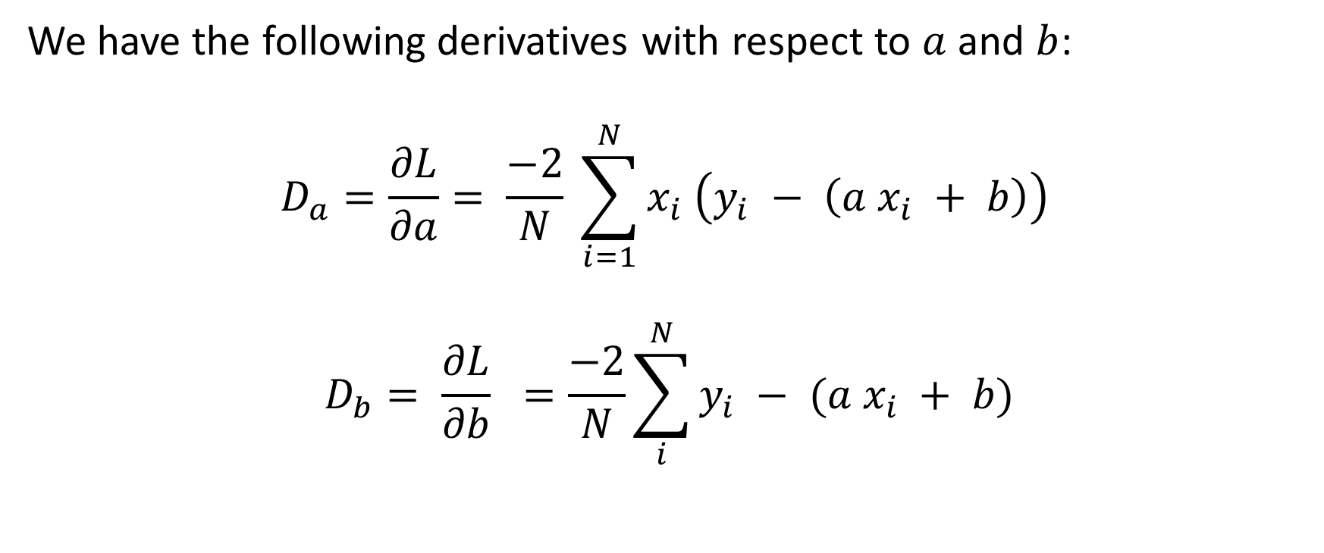
GD in Linear Regression
We have the following derivatives with respect to $a$ and $b$:
$$D_{a}=\frac{∂L}{∂a}= \frac{−2}{N} \sum_{i=1}^{N}{x_{i} \left(y_{i} − \left(a x_{i} + b\right)\right)}$$
$$D_{b}= \frac{∂L}{∂b} =\frac{−2}{N}\sum_{i}^{N}{y_{i} − (a x_{i} + b)}$$

Slide 10
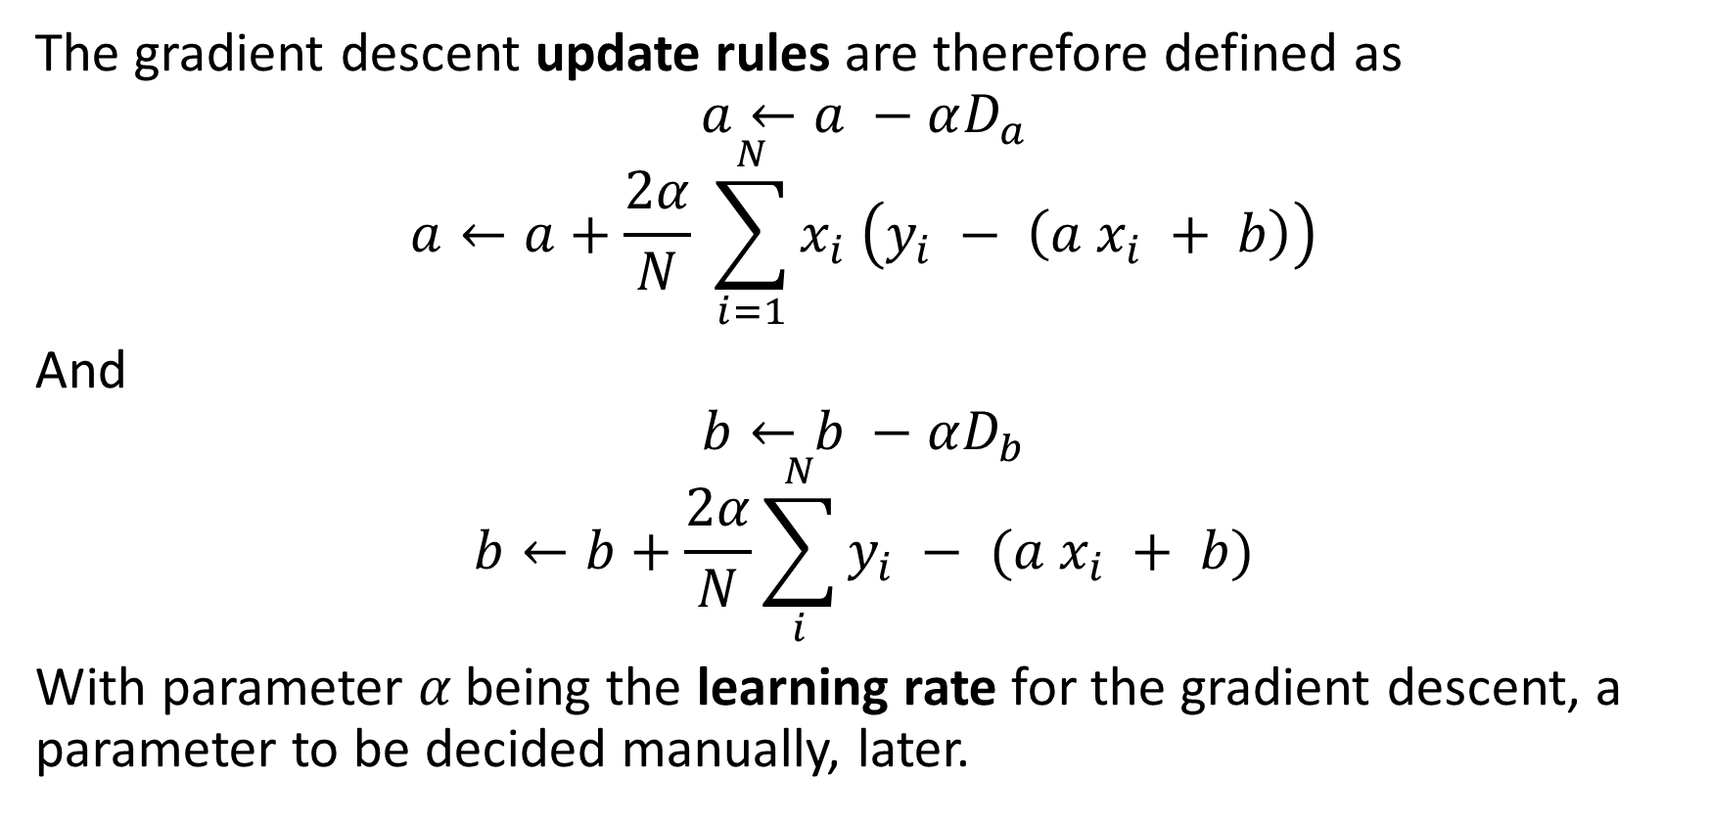
GD in Linear Regression
The gradient descent update rules are therefore defined as
$$a←a −αD_{a}$$
$$a←a+\frac{2α}{N} \sum_{i=1}^{N}{x_{i} \left(y_{i} − \left(a x_{i} + b\right)\right)}$$
And
$$b←b −αD_{b}$$
$$b←b+\frac{2α}{N}\sum_{i}^{N}{y_{i} − (a x_{i} + b)}$$
With parameter 𝛼 being the learning rate for the gradient descent, a parameter to be decided manually, later.

Slide 11
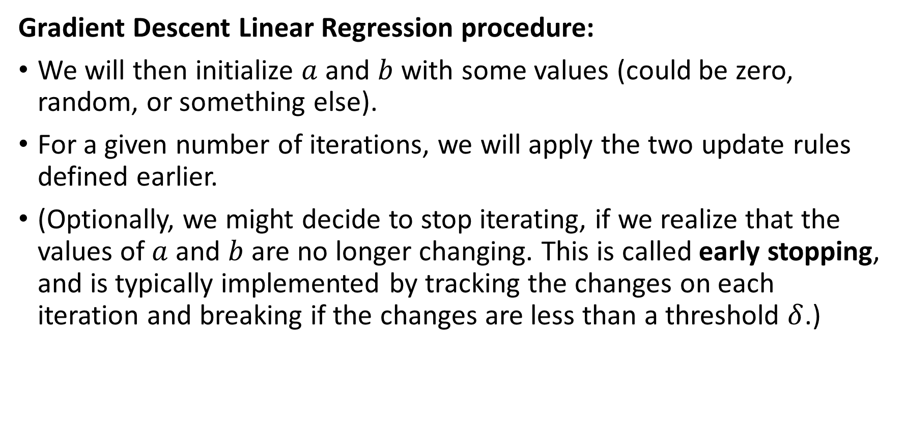
GD in Linear Regression
Gradient Descent Linear Regression procedure:
We will then initialize $a$ and $b$ with some values (could be zero, random, or something else).
For a given number of iterations, we will apply the two update rules defined earlier.
(Optionally, we might decide to stop iterating, if we realize that the values of $a$ and $b$ are no longer changing. This is called early stopping, and is typically implemented by tracking the changes on each iteration and breaking if the changes are less than a threshold $δ$.)

Slide 12
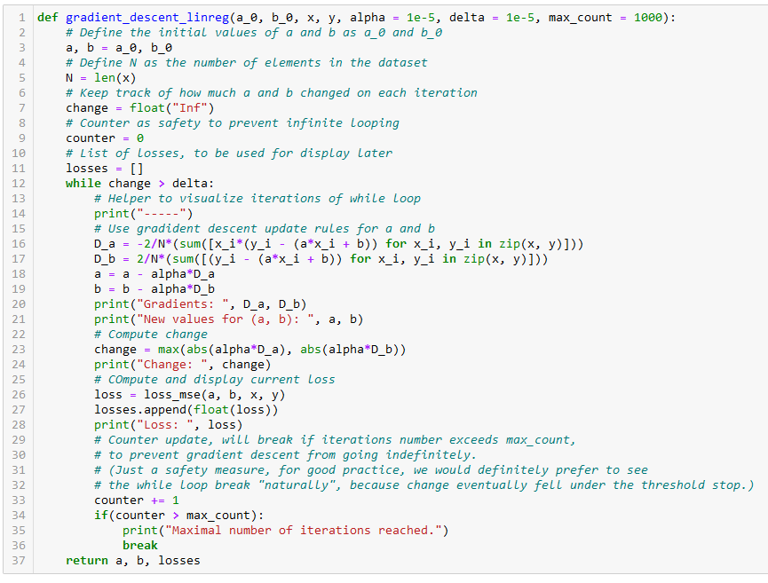
Initialize a and b as you please.

Slide 13
Number of samples in dataset.

Slide 14
Two possible stopping conditions, change < delta or counter > max_count

Slide 15
Update using our GD update rules from earlier

Slide 16
Compute change on this iteration (to decide on early stopping or not)

Slide 17
Calculate new MSE value using the new parameters a and b. We also keep track of these losses for display later

Slide 18
Return trained parameters and losses evolution on each iteration

Slide 19
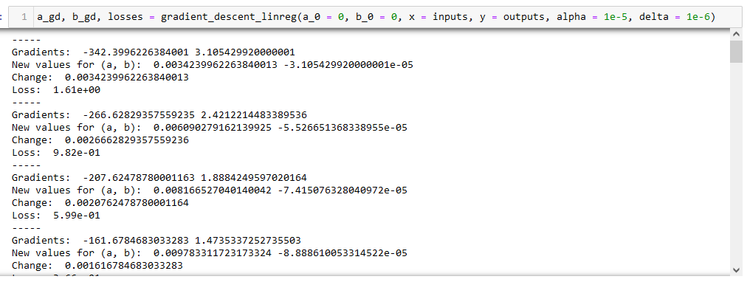

Slide 20
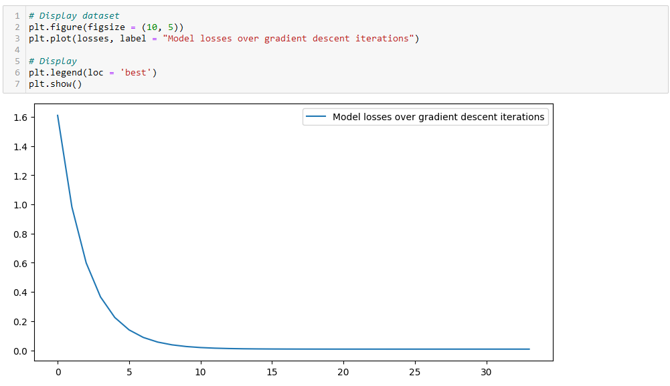

Slide 21
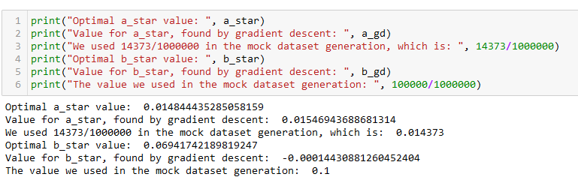
Checking for optimal parameters
We have generated the dataset ourselves, so we know what should be the values for a and b!

Slide 22
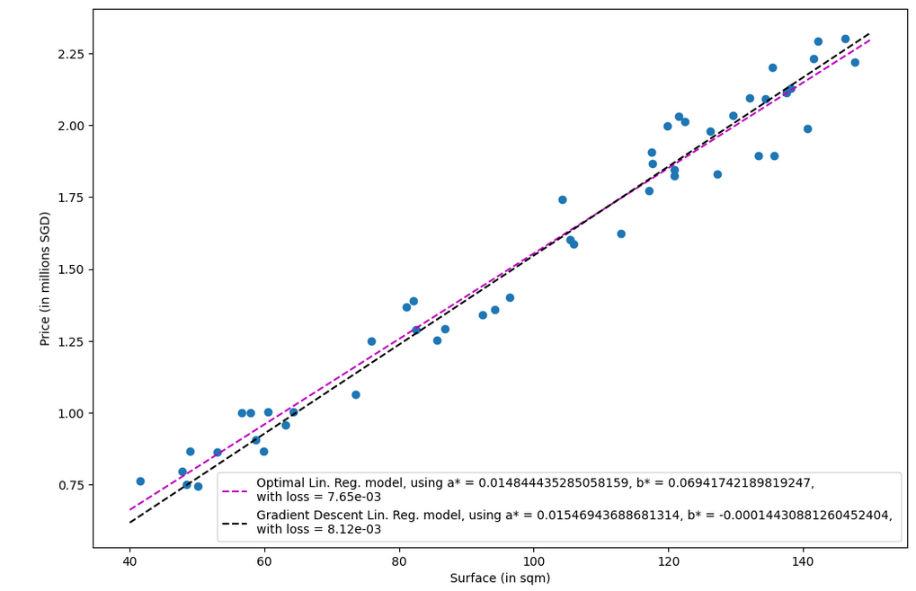

Slide 23
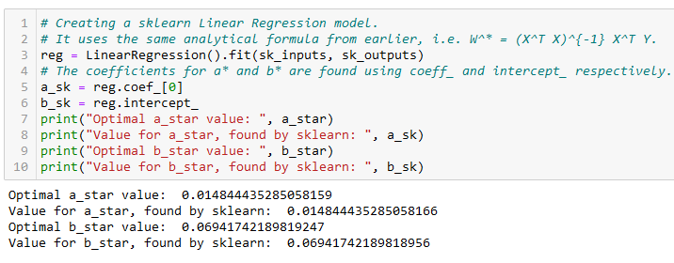
Using Sklearn for Linear regression
In practice, we never implement the linear regression model ourselves (but it is a good practice to try it at least once!)
It is often faster to rely on the sklearn library and use the LinearRegression object!

Slide 24
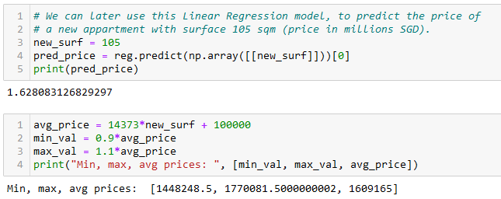
Predicting using Sklearn Linear regression
After training, it is also good practice to check if the predictor makes sense, by asking it to predict the price of an apartment it has never seen before.
Confirm the value manually, if possible.

Slide 25
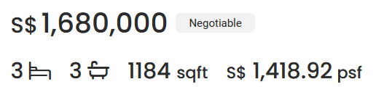
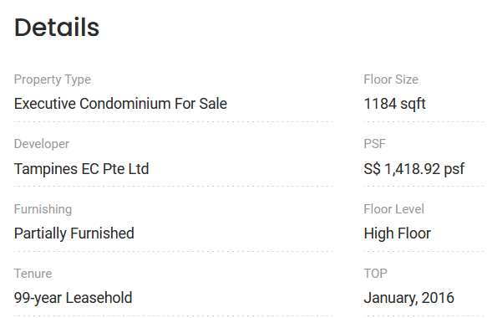

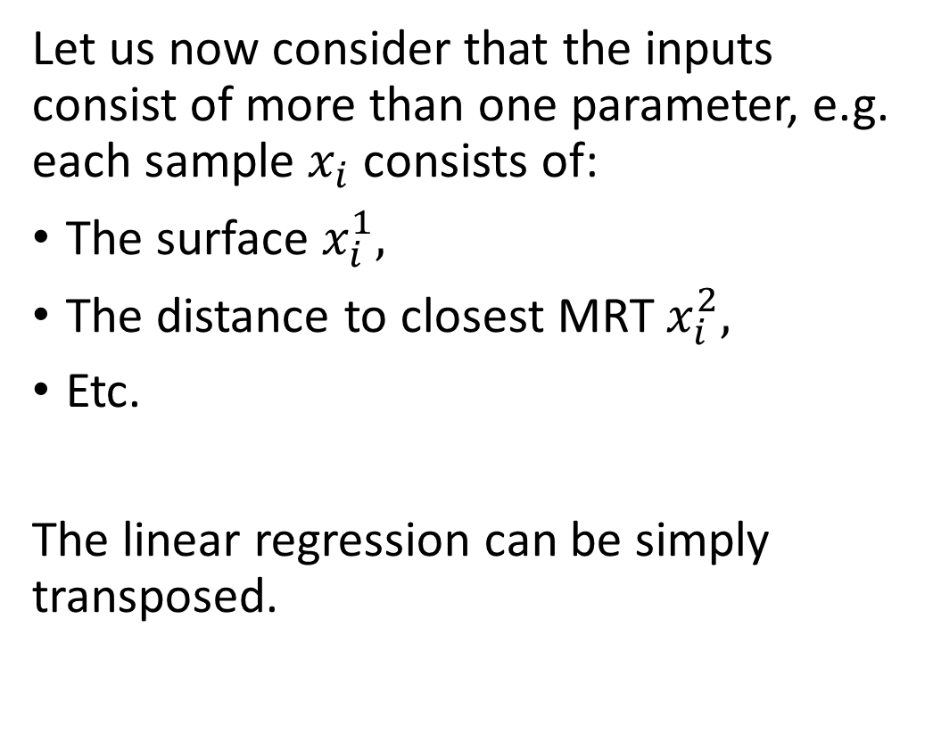
Extension of multi-parameter Linear Regression
Let us now consider that the inputs consist of more than one parameter, e.g. each sample $x_{i}$ consists of:
The surface $x_{i}^{1},$
The distance to closest MRT $x_{i}^{2},$
Etc.
The linear regression can be simply transposed.

Slide 26
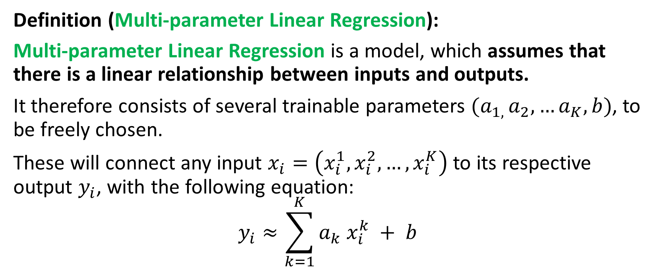
Extension of multi-parameter Linear Regression
Definition (Multi-parameter Linear Regression):
Multi-parameter Linear Regression is a model, which assumes that there is a linear relationship between inputs and outputs.
It therefore consists of several trainable parameters $(a_{1, }a_{2},…a_{K},b)$, to be freely chosen.
These will connect any input $x_{i}=\left(x_{i}^{1},x_{i}^{2},…,x_{i}^{K}\right)$ to its respective output $y_{i}$, with the following equation:
$$y_{i}≈\sum_{k=1}^{K}{a_{k} x_{i}^{k}} + b$$

Slide 27
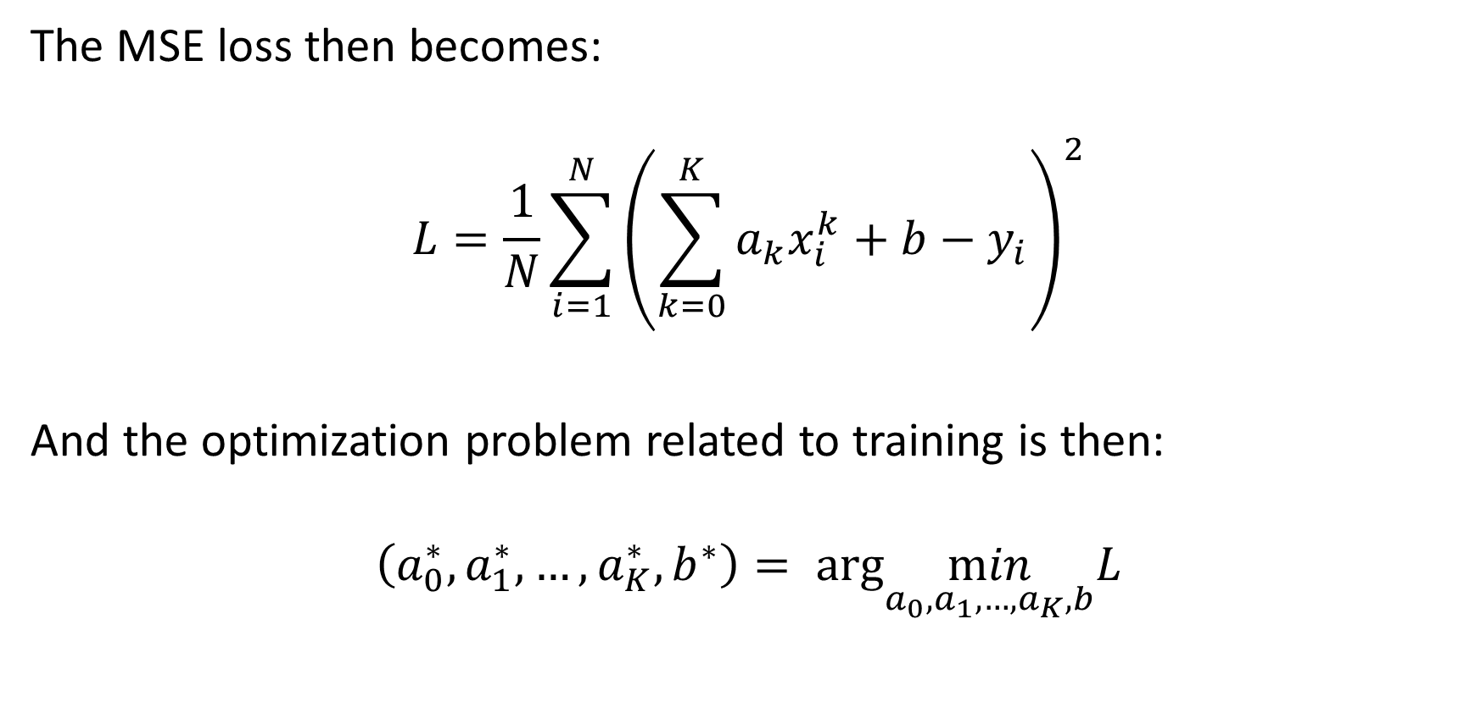
Extension of multi-parameter Linear Regression
The MSE loss then becomes:
$$L=\frac{1}{N}\sum_{i=1}^{N}{{\left(\sum_{k=0}^{K}{a_{k}x_{i}^{k}}+b−y_{i}\right)}^{2}}$$
And the optimization problem related to training is then:
$$\left(a_{0}^{∗},a_{1}^{∗}, …,a_{K}^{∗}, b^{∗}\right)= arg\min_{a_{0},a_{1},…,a_{K},b}L$$

Slide 28
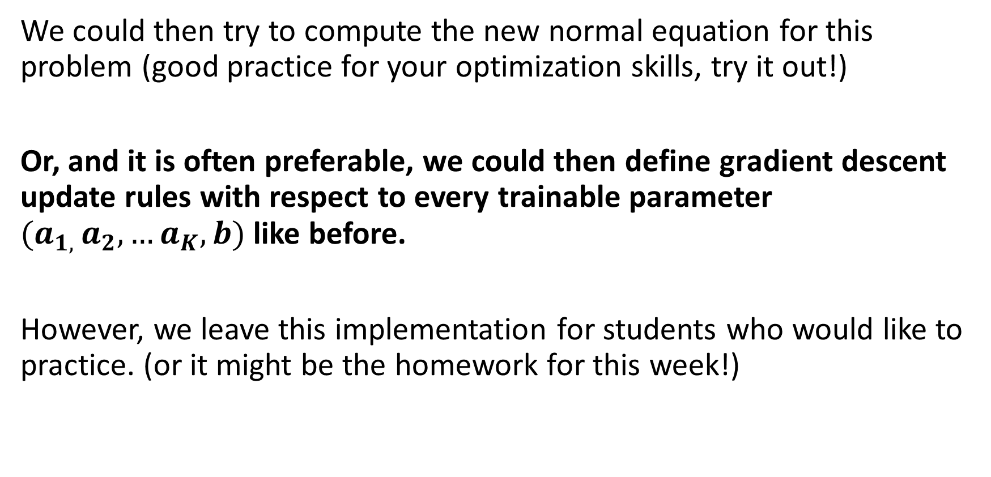
Extension of multi-parameter Linear Regression
We could then try to compute the new normal equation for this problem (good practice for your optimization skills, try it out!)
Or, and it is often preferable, we could then define gradient descent update rules with respect to every trainable parameter $(a_{1, }a_{2},…a_{K},b)$ like before.
However, we leave this implementation for students who would like to practice. (or it might be the homework for this week!)

Slide 29
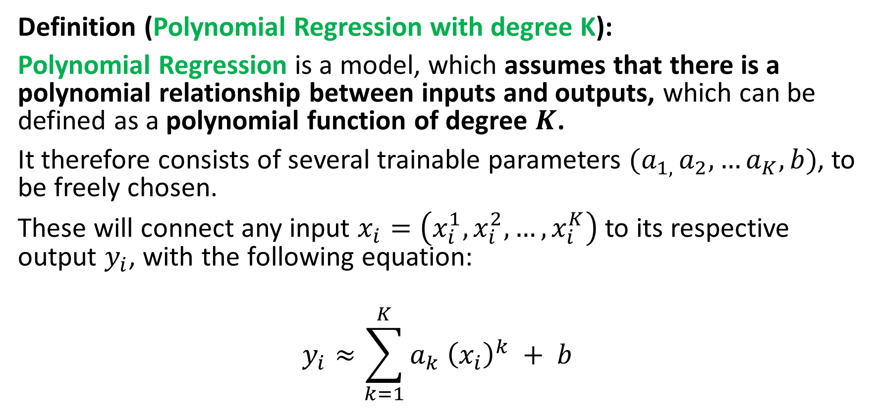
From Linear to Polynomial Regression
Definition (Polynomial Regression with degree K):
Polynomial Regression is a model, which assumes that there is a polynomial relationship between inputs and outputs, which can be defined as a polynomial function of degree $K$.
It therefore consists of several trainable parameters $(a_{1, }a_{2},…a_{K},b)$, to be freely chosen.
These will connect any input $x_{i}=\left(x_{i}^{1},x_{i}^{2},…,x_{i}^{K}\right)$ to its respective output $y_{i}$, with the following equation:
$$y_{i}≈\sum_{k=1}^{K}{a_{k} {\left(x_{i}\right)}^{k}} + b$$

Slide 30
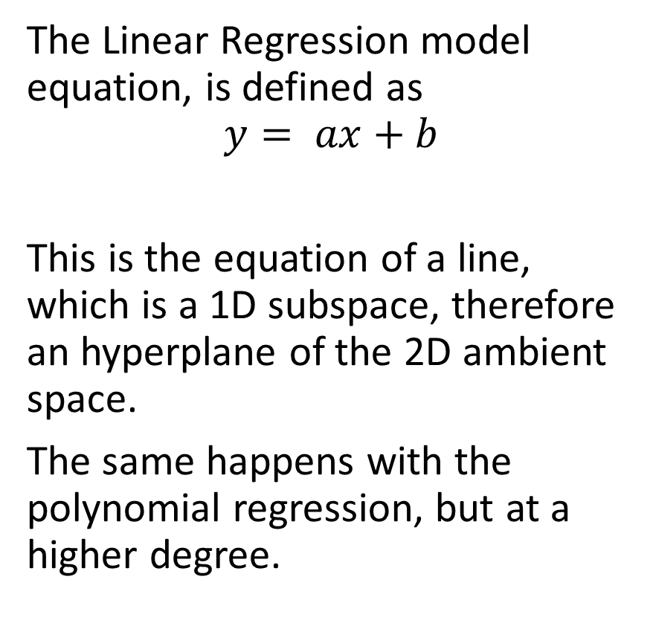
The hyperplane concept
Definition (Hyperplanes in Linear Algebra):
A hyperplane is a subspace of one dimension less than the ambient space.
In the case of linear regression with one input feature and one output feature, the ambient space is of dimension 2 (that is 1+1).
The Linear Regression model equation, is defined as
$$y= ax+b$$
This is the equation of a line, which is a 1D subspace, therefore an hyperplane of the 2D ambient space.
The same happens with the polynomial regression, but at a higher degree.

Slide 31
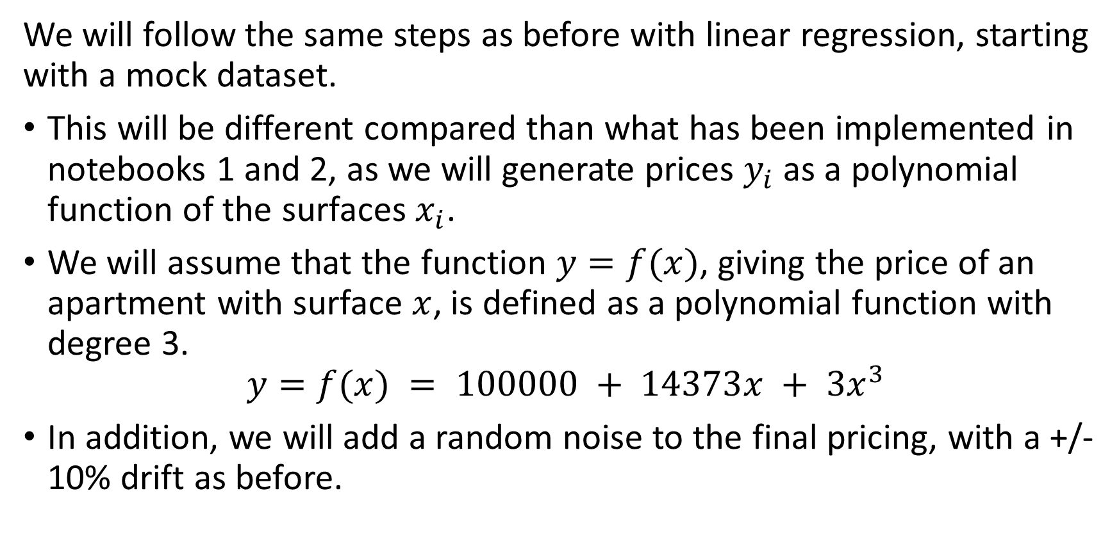
From Linear to Polynomial Regression
We will follow the same steps as before with linear regression, starting with a mock dataset.
This will be different compared than what has been implemented in notebooks 1 and 2, as we will generate prices $y_{i}$ as a polynomial function of the surfaces $x_{i}$.
We will assume that the function $y=f(x)$, giving the price of an apartment with surface $x$, is defined as a polynomial function with degree 3.
$$y=f(x) = 100000 + 14373x + 3x^{3}$$
In addition, we will add a random noise to the final pricing, with a +/- 10% drift as before.

Slide 32
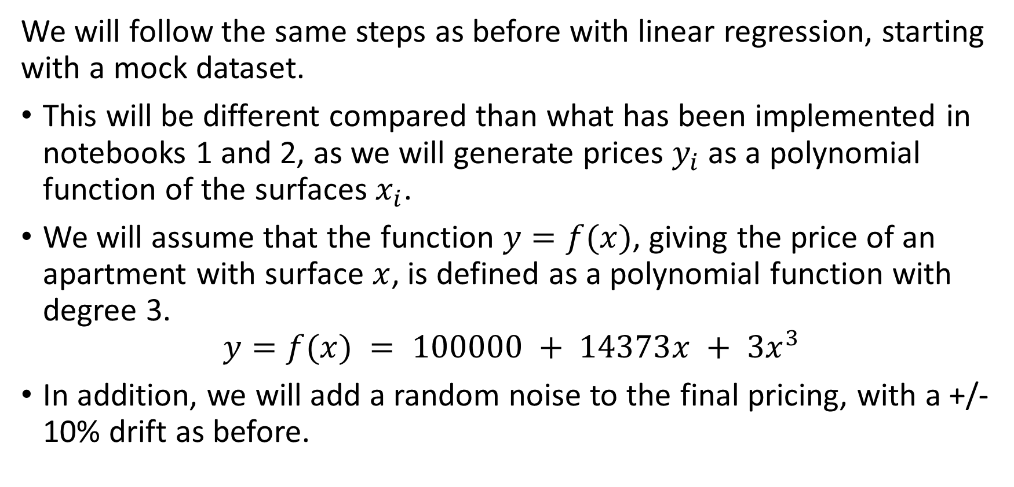
From Linear to Polynomial Regression
We will follow the same steps as before with linear regression, starting with a mock dataset.
This will be different compared than what has been implemented in notebooks 1 and 2, as we will generate prices $y_{i}$ as a polynomial function of the surfaces $x_{i}$.
We will assume that the function $y=f(x)$, giving the price of an apartment with surface $x$, is defined as a polynomial function with degree 3.
$$y=f(x) = 100000 + 14373x + 3x^{3}$$
In addition, we will add a random noise to the final pricing, with a +/- 10% drift as before.

Slide 33
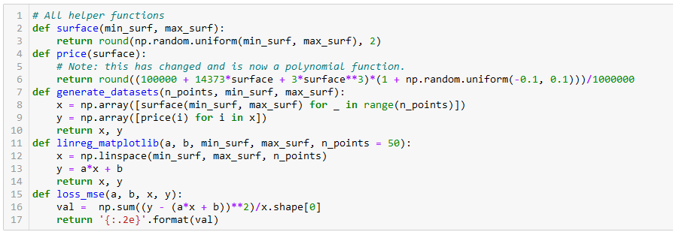
From Linear to Polynomial Regression

Slide 34
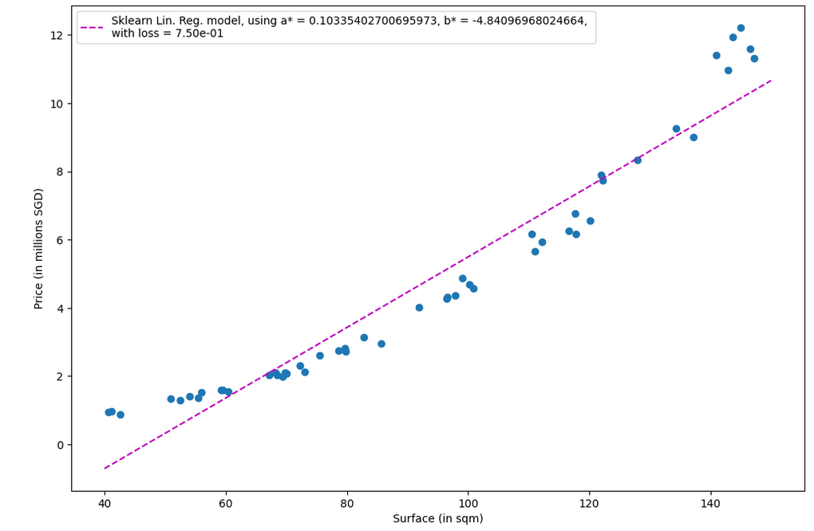
Data no longer shows linearity, which is expected.
Using a Linear Regressor would be a mistake, as it would not properly fit the data.

Slide 35
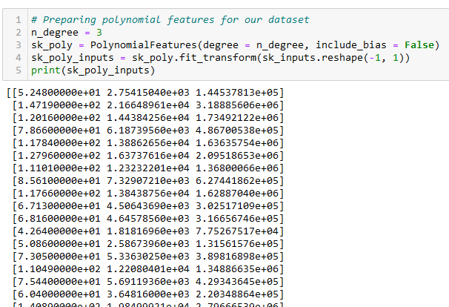
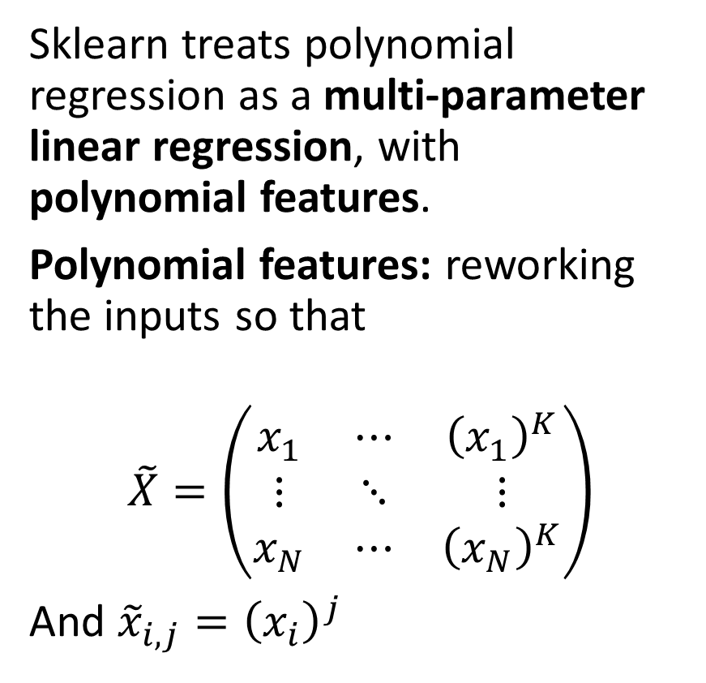
Polynomial Regression with sklearn
Sklearn treats polynomial regression as a multi-parameter linear regression, with polynomial features.
Polynomial features: reworking the inputs so that
$$\tilde{X}=\left(\begin{matrix}x_{1} & ⋯ & {\left(x_{1}\right)}^{K} \\ ⋮ & ⋱ & ⋮ \\ x_{N} & ⋯ & {\left(x_{N}\right)}^{K}\end{matrix}\right)$$
And ${\tilde{x}}_{i,j}={\left(x_{i}\right)}^{j}$

Slide 36
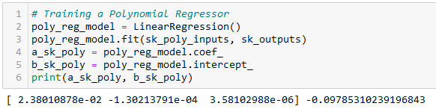

Polynomial Regression with sklearn
We then proceed normally, assuming $\tilde{X}$ are our new inputs.
Sklearn then automatically adjusts and produces the right number of parameters for the model.

Slide 37
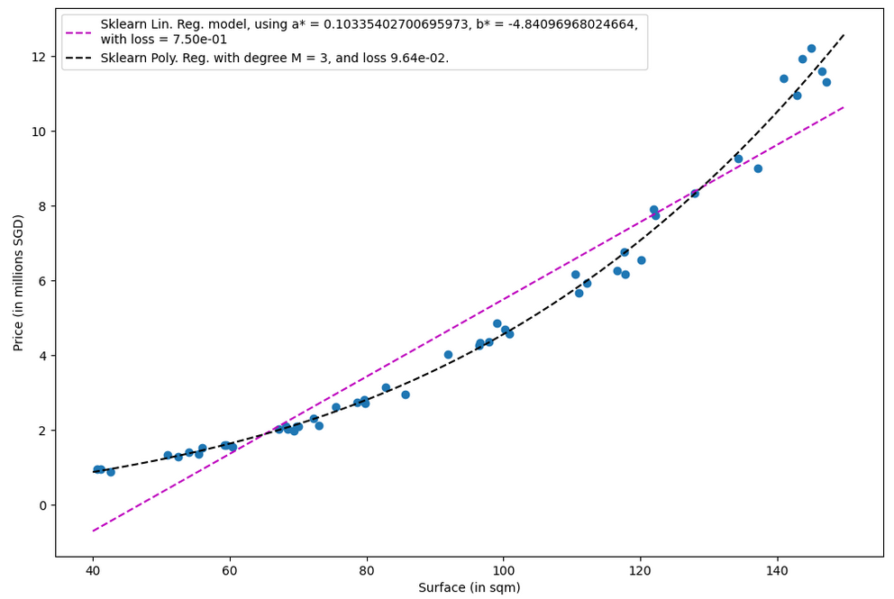
A much better fit, with a lower MSE loss

Slide 38
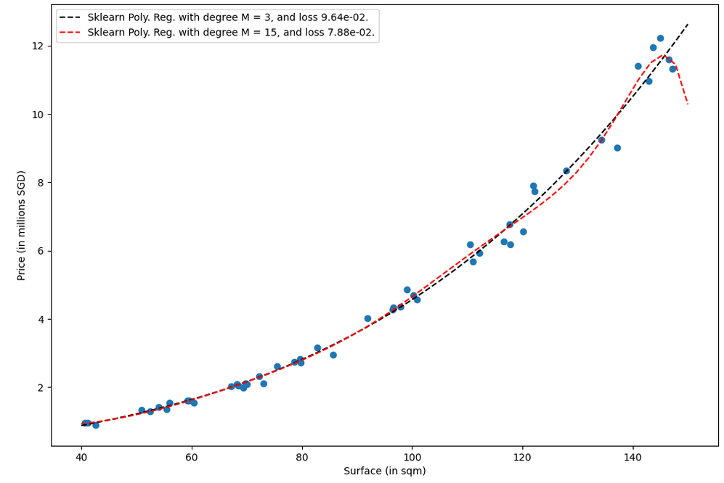
Be careful however on the degree you use for the polynomial regression.
Higher degree is not always better!

Slide 39
Be careful however on the degree you use for the polynomial regression.
Higher degree is not always better!
Red model (high degree) will struggle to predict price of a 150sqm apartment!

Slide 40
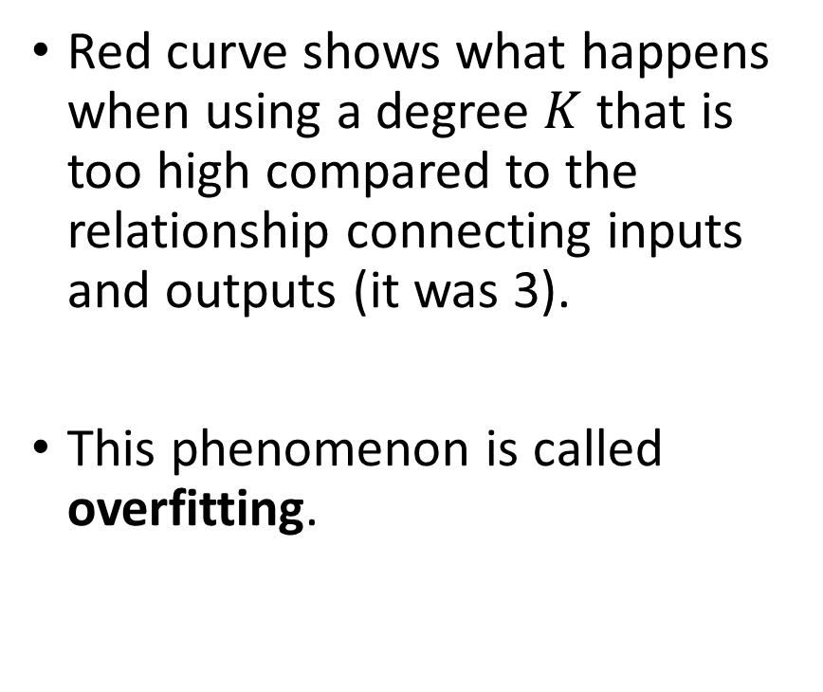
Overfitting vs. degree of polynomial
Red curve shows what happens when using a degree $K$ that is too high compared to the relationship connecting inputs and outputs (it was 3).
This phenomenon is called overfitting.

Slide 41
Overfitting vs. degree of polynomial
Definition (Overfitting):
Overfitting is a phenomenon that occurs in machine learning when a model is trained too well on the training data.
As a result, it performs poorly on new, unseen data (here an apartment with 150sqm surface, which we had not in the training dataset).

Slide 42
Overfitting vs. degree of polynomial
Definition (Overfitting):
Overfitting is a phenomenon that occurs in machine learning when a model is trained too well on the training data.
As a result, it performs poorly on new, unseen data (here an apartment with 150sqm surface, which we had not in the training dataset).
This typically happens when
a model is trained with too many features
or too much data,
It becomes too complex for the task at hand, resulting in poor generalization to new data.
In other words, it memorizes the noise in the training data rather than learning the correct underlying pattern.

Slide 43
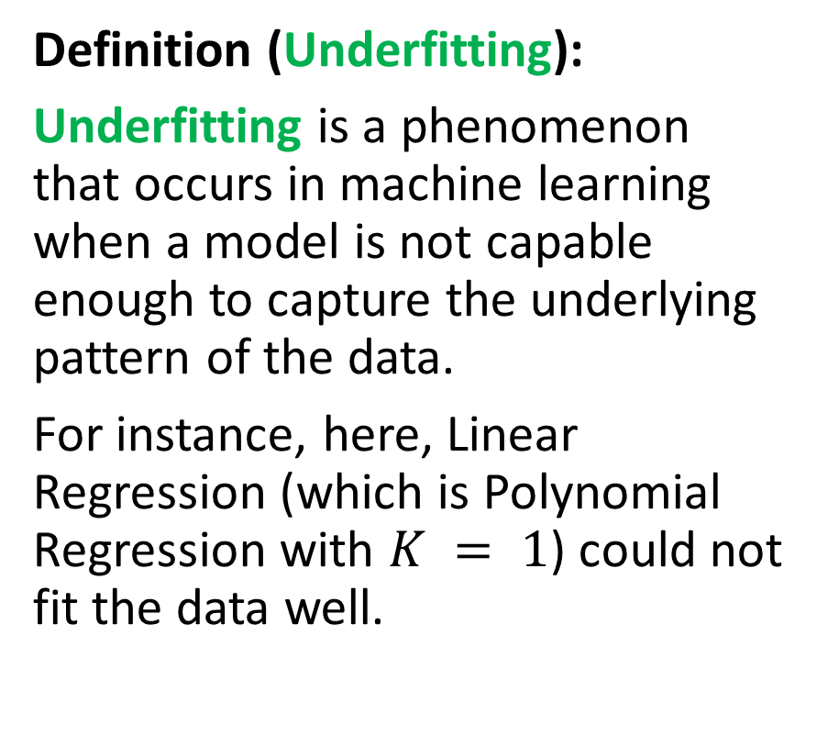
Underfitting vs. degree of polynomial
Definition (Underfitting):
Underfitting is a phenomenon that occurs in machine learning when a model is not capable enough to capture the underlying pattern of the data.
For instance, here, Linear Regression (which is Polynomial Regression with $K = 1$) could not fit the data well.

Slide 44
Underfitting vs. degree of polynomial
Definition (Underfitting):
Underfitting is a phenomenon that occurs in machine learning when a model is not capable enough to capture the underlying pattern of the data.
For instance, here, Linear Regression (which is Polynomial Regression with $K = 1$) could not fit the data well.
This can happen when a model
is trained with too few features
or too little data,
or when the model is not powerful enough to capture the complexity of the task.

Slide 45
Generalization
Definition (Generalization):
Generalization is considered the "holy grail" of machine learning because it is the ultimate goal of any machine learning model.
Even though the model was trained on seen data we collected, the purpose of a machine learning model is to make accurate predictions on new, unseen data.
If a model can make accurate predictions on data it has not seen before, it is said to have generalized well, and can then be used in the real world for solving the problem it was designed to solve.

Slide 46
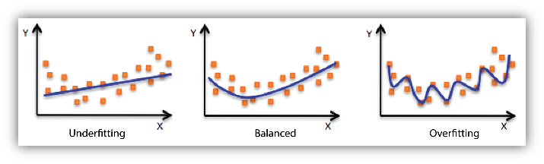
Generalization vs. Overfitting/Underfitting
In general, having a model that is underfitting or overfitting will lead to poor generalization.
We would very much prefer to fit the data “just right”.

Slide 47
While we are at it…
In general, we want to:
Train the model was trained on data we collected,
Confirm that the model can generalize and make accurate predictions on new, unseen data, after training.
Problem: We would prefer to test the model before releasing it in the wild (what if it is wrong?)
Problem #2: Testing its generalization capabilities on the same data that was used for training would NOT confirm generalization.
Solution: Use some of our seen data to train the model, and some of the data (that has not been used for training and is therefore unseen to the model yet) for evaluating its generalization.

Slide 48
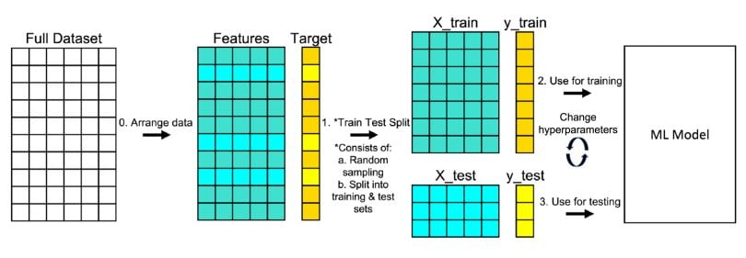
Train and test split
Definition (Train and Test Split):
Train and test split is a method used in machine learning to divide a dataset into two subsets:
The training set is used to train the model
The test set is used to evaluate the performance of the trained model.
The idea is to use a portion of the dataset for training and a separate portion for testing so that the model can be evaluated on unseen data.
The typical split is to use 80% of the data for training and 20% for testing.
This can however vary depending on the specific use case and the size of the dataset.

Slide 49
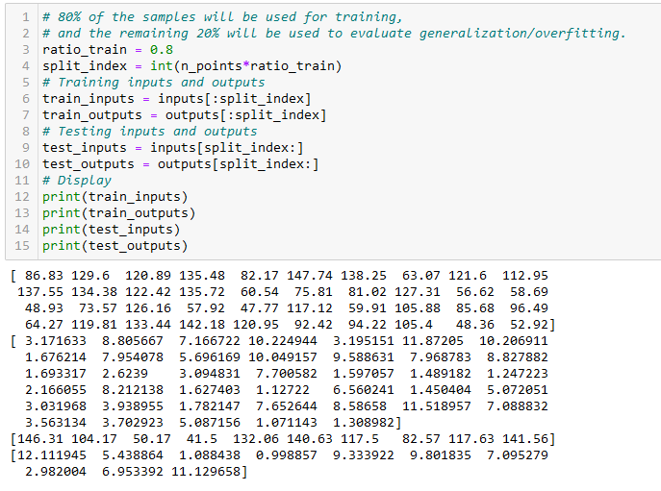
Train and test split

Slide 50
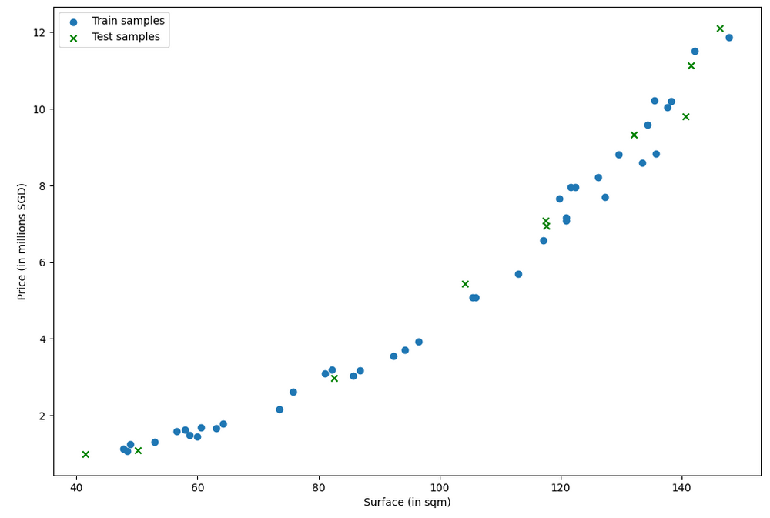

Slide 51
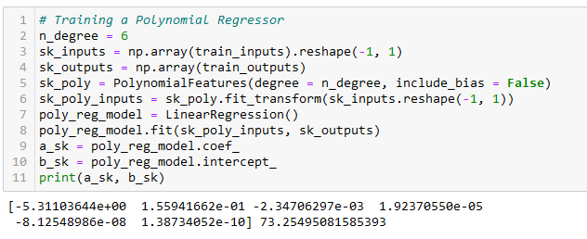
Training the Polynomial Regressor, again
This time, we only train the polynomial regressor on the training data.
After training, evaluate loss using the test data.

Slide 52
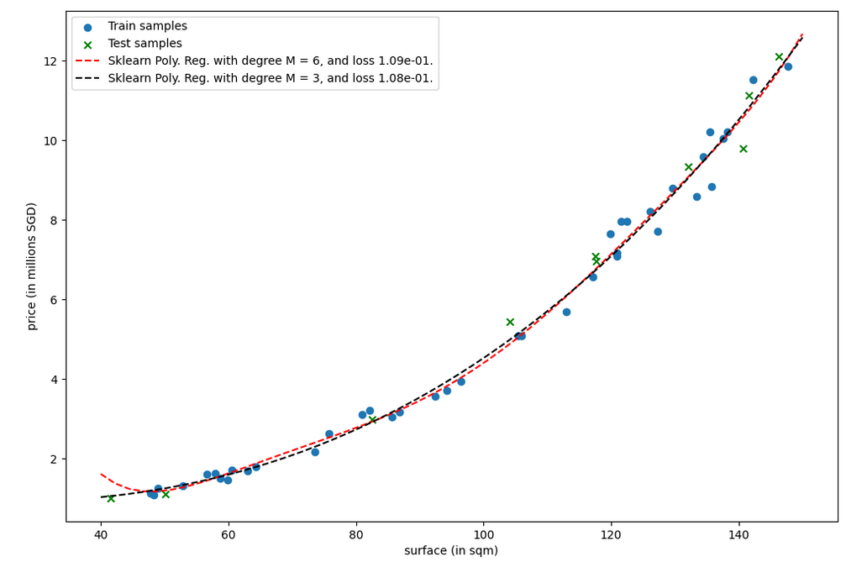
Red curve is higher degree polynomial regression. While it seems like it should perform better than black, its test loss is higher!
What could be the reason?

Slide 53
Red curve is higher degree polynomial regression. While it seems like it should perform better than black, its test loss is higher!
What could be the reason?
Bad fitting on low surface apartments!
(No apartment with size less than 45sqm in train dataset!)

Slide 54
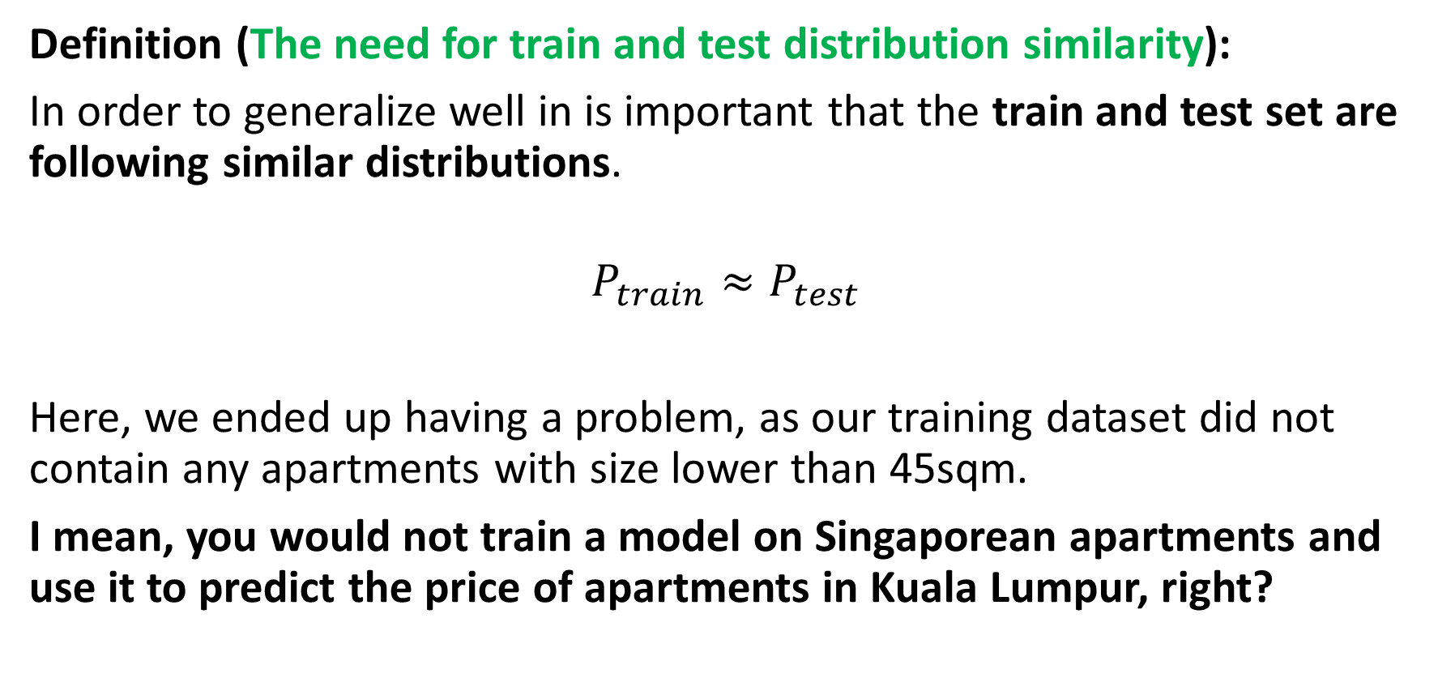
Generalization vs. Train/Test Distributions
Definition (The need for train and test distribution similarity):
In order to generalize well in is important that the train and test set are following similar distributions.
$$P_{train}≈P_{test}$$
Here, we ended up having a problem, as our training dataset did not contain any apartments with size lower than 45sqm.
I mean, you would not train a model on Singaporean apartments and use it to predict the price of apartments in Kuala Lumpur, right?

Slide 55
But then, why did black end up being ok then? It had not seen the <45sqm data either!

Slide 56
Regularization
Definition (Regularization):
Regularization consists of helping the model avoid overfitting (which is usually more prominent than underfitting).
It can typically be done by making sure the model is not too complex for the data, but many other approaches exist.
In general,
the more complex the data is (in terms of features), the more complex the model can be.
the more data you have (in terms of quantity of individual samples in dataset), the more complex the model can be.

Slide 57
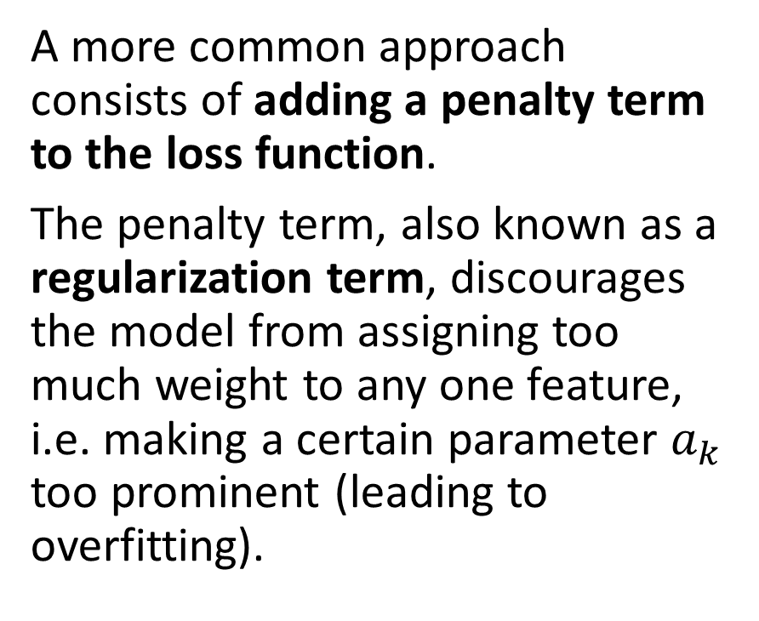
Regularization
Definition (Regularization):
Regularization consists of helping the model avoid overfitting (which is usually more prominent than underfitting).
It can typically be done by making sure the model is not too complex for the data, but many other approaches exist.
A more common approach consists of adding a penalty term to the loss function.
The penalty term, also known as a regularization term, discourages the model from assigning too much weight to any one feature, i.e. making a certain parameter $a_{k}$ too prominent (leading to overfitting).

Slide 58
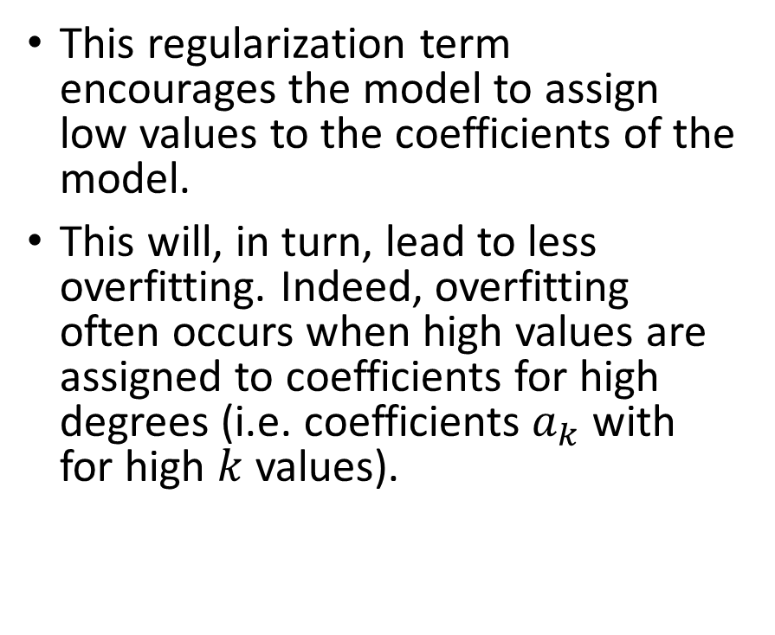
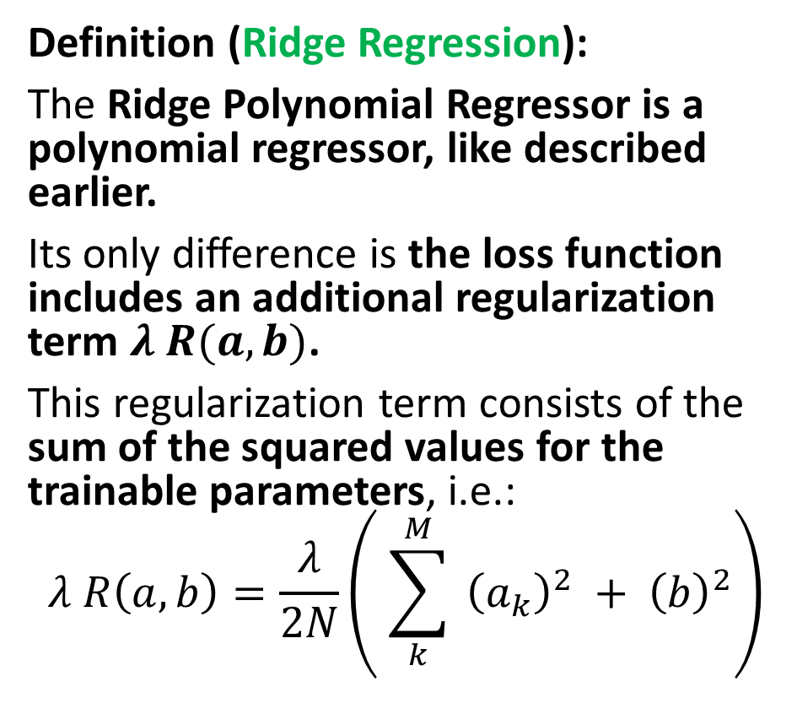
Regularization
Definition (Ridge Regression):
The Ridge Polynomial Regressor is a polynomial regressor, like described earlier.
Its only difference is the loss function includes an additional regularization term $λ R(a, b)$.
This regularization term consists of the sum of the squared values for the trainable parameters, i.e.:
$$λ R\left(a, b\right)=\frac{λ}{2N}\left( \sum_{k}^{M}{{ \left(a_{k}\right)}^{2}} + {\left(b\right)}^{2}\right)$$
This regularization term encourages the model to assign low values to the coefficients of the model.
This will, in turn, lead to less overfitting. Indeed, overfitting often occurs when high values are assigned to coefficients for high degrees (i.e. coefficients $a_{k}$with for high $k$ values).

Slide 59
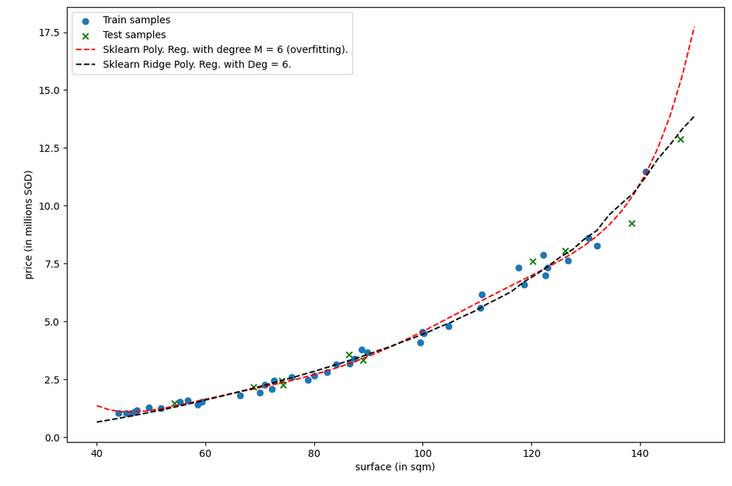

Slide 60
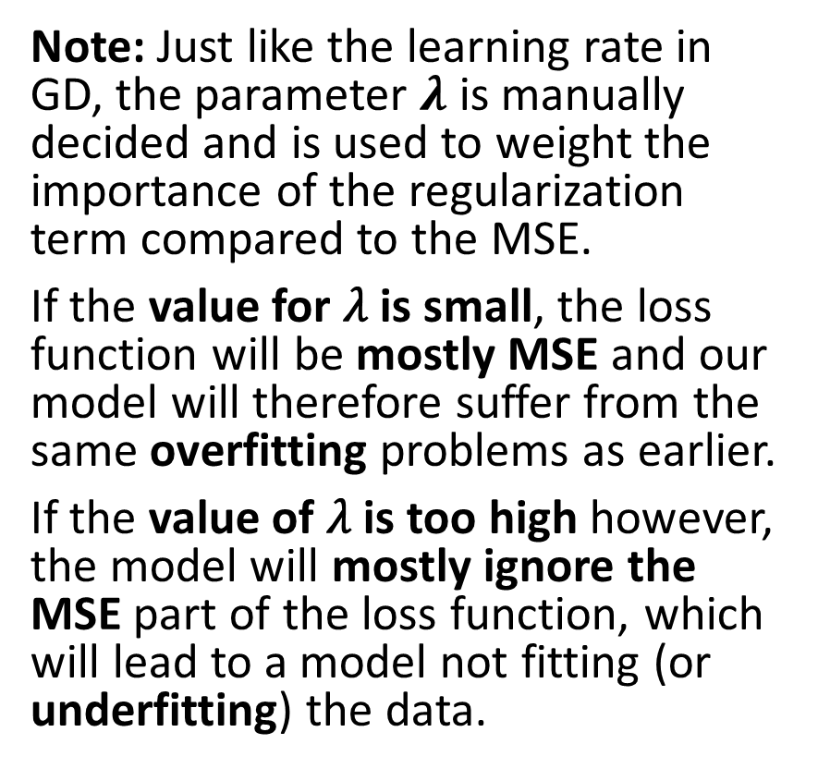
Regularization
Definition (Ridge Regression):
The Ridge Polynomial Regressor is a polynomial regressor, like described earlier.
Its only difference is the loss function includes an additional regularization term $λ R(a, b)$.
This regularization term consists of the sum of the squared values for the trainable parameters, i.e.:
$$λ R\left(a, b\right)=\frac{λ}{2N}\left( \sum_{k}^{M}{{ \left(a_{k}\right)}^{2}} + {\left(b\right)}^{2}\right)$$
Note: Just like the learning rate in GD, the parameter $λ$ is manually decided and is used to weight the importance of the regularization term compared to the MSE.
If the value for 𝜆 is small, the loss function will be mostly MSE and our model will therefore suffer from the same overfitting problems as earlier.
If the value of 𝜆 is too high however, the model will mostly ignore the MSE part of the loss function, which will lead to a model not fitting (or underfitting) the data.

Slide 61
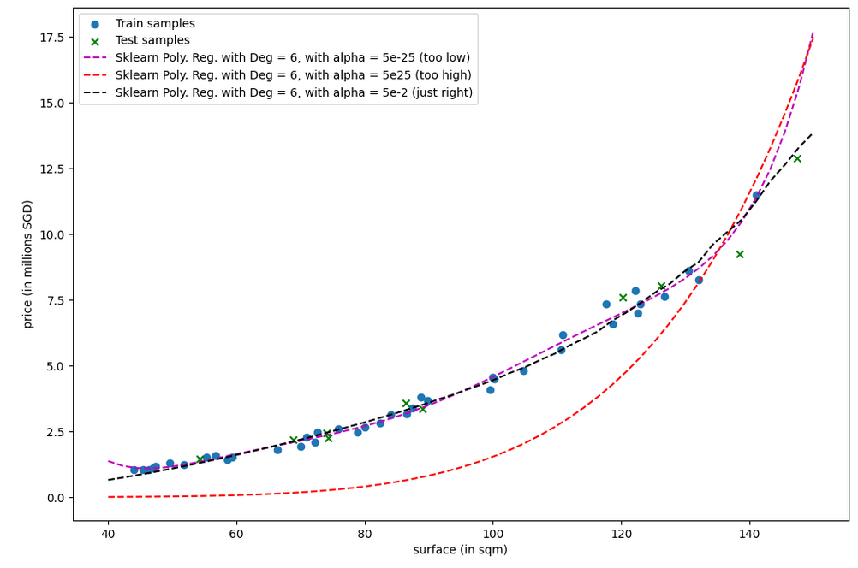

Slide 62
Regularization
Definition (Ridge Regression):
The Ridge Polynomial Regressor is a polynomial regressor, like described earlier.
Its only difference is the loss function includes an additional regularization term $λ R(a, b)$.
This regularization term consists of the sum of the squared values for the trainable parameters, i.e.:
$$λ R\left(a, b\right)=\frac{λ}{2N}\left( \sum_{k}^{M}{{ \left(a_{k}\right)}^{2}} + {\left(b\right)}^{2}\right)$$
Note #2: it is also possible to use the sum of absolute values, making a Lasso Regressor instead.
Why use L1 regularization over L2 regularization?
L1 regularization results in some weights being exactly equal to zero, which can be used for feature selection.
L2 regularization will not produce sparse models, and it will only shrink the weights.

Slide 63
Regularization
Definition (Ridge Regression):
The Ridge Polynomial Regressor is a polynomial regressor, like described earlier.
Its only difference is the loss function includes an additional regularization term $λ R(a, b)$.
This regularization term consists of the sum of the squared values for the trainable parameters, i.e.:
$$λ R\left(a, b\right)=\frac{λ}{2N}\left( \sum_{k}^{M}{{ \left(a_{k}\right)}^{2}} + {\left(b\right)}^{2}\right)$$
Note #3: it is also possible to use the sum of absolute values AND squared values as regularization
Essentially getting the best of both worlds, and making an Elastic Regressor instead!
Check it out!

